Slide 1

Why study masculinities? Origins of scholarly interest
Module 1

Slide 2
Module 1 (5 classes) Ideas to explore in this module
Why study masculinities?
Historical evolution of masculinities studies
Theoretical/disciplinary perspectives
Important texts and scholars
Critical shifts in theorizing

Slide 3
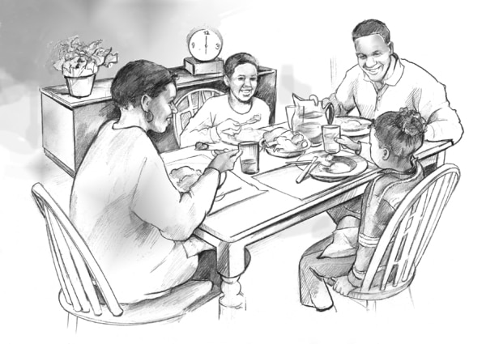
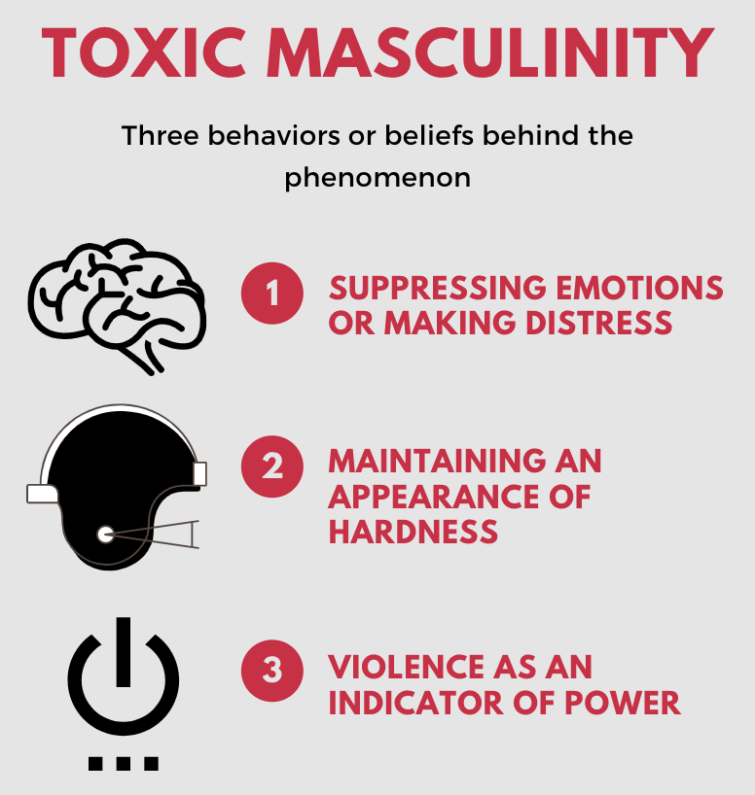

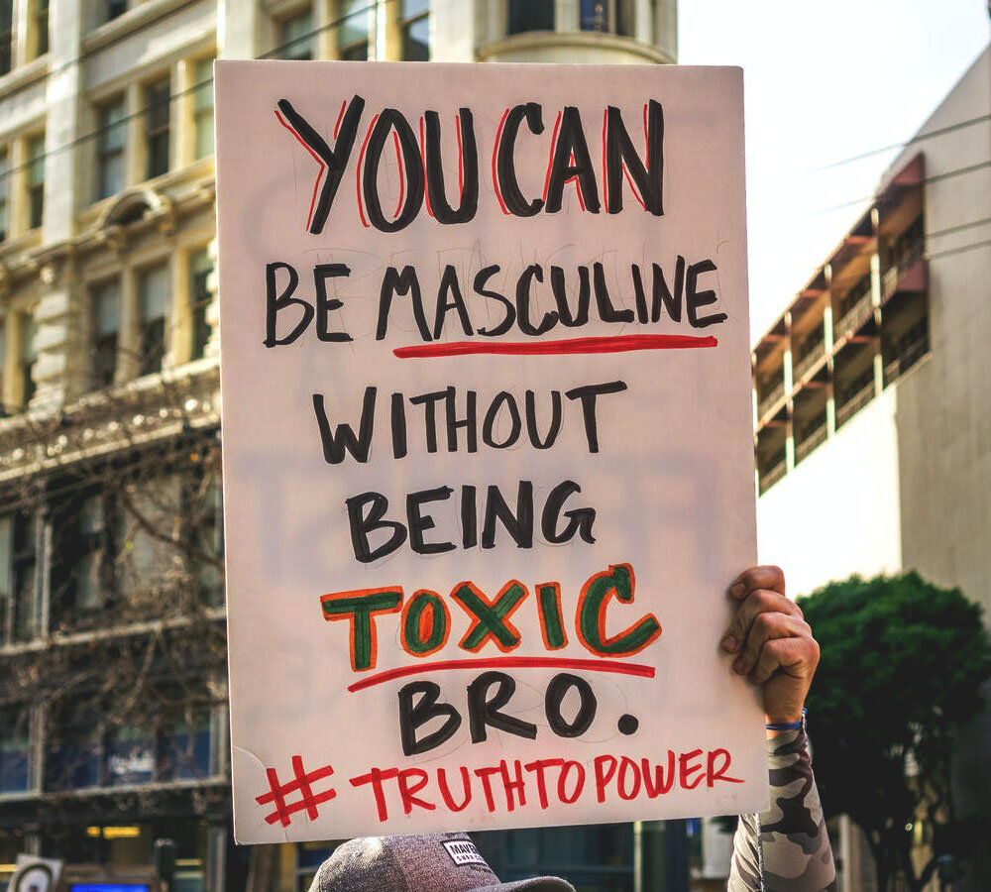
Masculinities in current public conversation
Traditional masculinity
- strong - rational - in control - objective - unemotional
Metrosexual
Young
Urban
Body/fashion conscious
Heterosexual
Macho
Use of physical force
Concealment of soft emotions

Slide 4
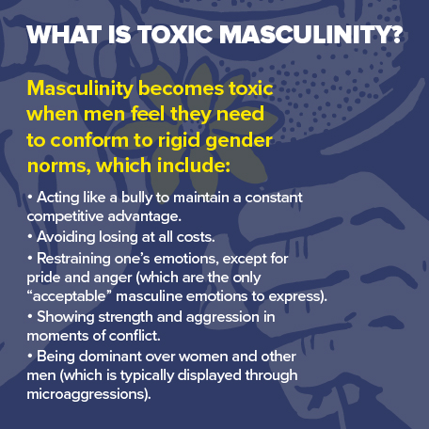

Slide 5
Why study masculinities?
Rigid/restrictive masculinities hinder gender equality
Gender is a key structure of society and is relational
Knowledge of masculinities has social implications
Violence
Physical and psychological health outcomes (alcohol and drug abuse, physical injuries, suicide, high rates of health distress and limited help-seeking
Gender inequality is a fundamental issue of social justice
Since 1990s increased attention in research, policy making, programmatic interventions in gender equality to masculinities

Slide 6
Two major trajectories of interest in masculinities
Activism
Women’s and
Gay rights
movements
Academic research
Psychology
Sociology
Gender Studies
Culminated in Men’s Studies and then renamed Masculinities Studies

Slide 7
Some psychological concepts

Slide 8
Some psychological concepts on making of masculinities
Identification and internalization
Male sex role identity
Hypermasculinity

Slide 9
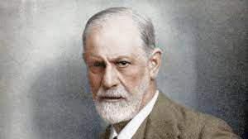
Origins in psychological research
Sigmund Freud’s Psychoanalysis first major attempt to explain masculinity [Three Essays on the Theory of Sexuality, 1905]
Human beings are constitutionally bisexual
“How do women and men develop out of a child with bisexual disposition?” (Freud, 1933)
Become heterosexual based on resolution of Oedipal crisis
Oedipal crisis: “Combination of love for one parent and simultaneous hatred for the other” (Freud, 1931)
Austrian physician
(1856-1939)
Biological essentialism argument

Slide 10
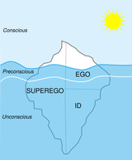
Sigmund Freud’s Psychoanalysis
Development of gender identity based on resolution of Oedipal crisis
For boys -- rivalry with father, terror of castration, subsequent identification with father – Oedipus complex resolved – development of superego
Girls – penis envy – discovery of lack of male organ turning point – rejection of (castrated) mother-- identification incomplete -- fulfilment of femininity through birth of son
Resolution of Oedipus complex defining moment of development of masculinity in boys and is internalized subsequently
Internalization facilitated by superego – what is ‘good/moral’ and what is bad/immoral’
Adult masculinity is organization of character around ‘proper’ object for sexual desire

Slide 11
Theory of male sex role identity
Lewis Terman & Catherine Miles [Sex and Personality, 1936]
Male or female sex role identity based on their biological sex
Sex role identity consists of perceived sex-appropriate traits, attitudes and interests
Psychological normality defined in terms of sex-appropriate characteristics
abnormality defined as deficit/lack of these sex-appropriate characteristics
homosexuality seen as extreme end of continuum of ‘deviation’ from normative male and female patterns
Biological essentialism argument

Slide 12
Theory of male sex role identity
Socio-cultural context of MSRI
1930s a period of the Great Depression in the US – “greatest single historical crisis in institutional basis of the traditional male role of breadwinner job” (Pleck, 1981)
WW II and aftermath
economic boom placed increasing demands on men to be good family providers through success in competitive economy
High incidence of emotional breakdowns in battle, physical and mental disqualification for recruitment – interpreted as failings of masculinity
Increasing numbers of women in paid work force meant transformations in male-female relationships and negotiating new ways of relating to women
Post-war spurt in divorce rates reflected this mismatch

Slide 13
Hypermasculinity
Exaggerated and extreme masculine behavior
As a defense against the man’s unconscious feminine identification
Cultural context in Europe and the US in 20th c.
Wartime male aggression and blind obedience as tools of a fascist state to mask timidity with sadistic version of masculinity
Adorno et al The Authoritarian Personality (1950)
Walter Langer The Mind of Adolf Hitler (1972)

Slide 14
sociology

Slide 15
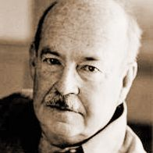
Sociology: Sex role theory
Instrumental (task-oriented) associated with men
Expressive (emotional warmth-oriented) associated with women
Aggressiveness, strength, competitiveness in men
Compliance, nurturance, cooperativeness in women
I-E differentiation meant duality of masculine and feminine characteristics
Division of labour in nuclear family based on differentiation of two roles
Talcott Parsons
(1902-1979)
American sociologist
Laid foundation for later conceptualization of ‘provider-protector’ and ‘nurturant’ roles for men and women
Rejected biological differences argument
How is this learnt?
Gender socialization -- Children learn gender patterning of roles that is transmitted across generations
Parsons & Bales
Family Socialization and Interaction Process (1955)

Slide 16
Origins of ms in movements

Slide 17
Origins of MS traced to women’s and gay rights movements
Second-wave feminist movement in the West and changes since the 1960s
Increasing numbers of women in paid work force challenged traditional sexual division of labour and roles
Access to contraception
Key contribution of women’s/gender studies
Relationship between gender and power
Showed how in patriarchal societies socio-economic advantage, privilege is in hands of men
Questioning of traditional understanding of what it is to be a man by gay rights movement
Changes in women meant need for change in men too

Slide 18
Emergence of Masculinities studies from Feminism and Gender Studies in the west
Focus on social problems since the 1950s in US
Juvenile delinquency and educational underachievement attributed to ‘father absence’
precursor to masculinities studies
first sociological discussion of conflicts in constructions of masculinity

Slide 19
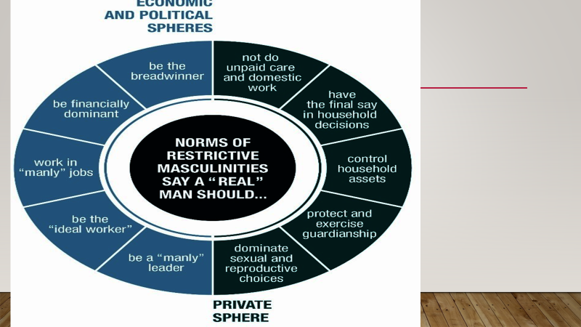
Emergence of Masculinities studies from Feminism and Gender Studies
Realization of the harms of rigid/restrictive masculinity

